Slide 1
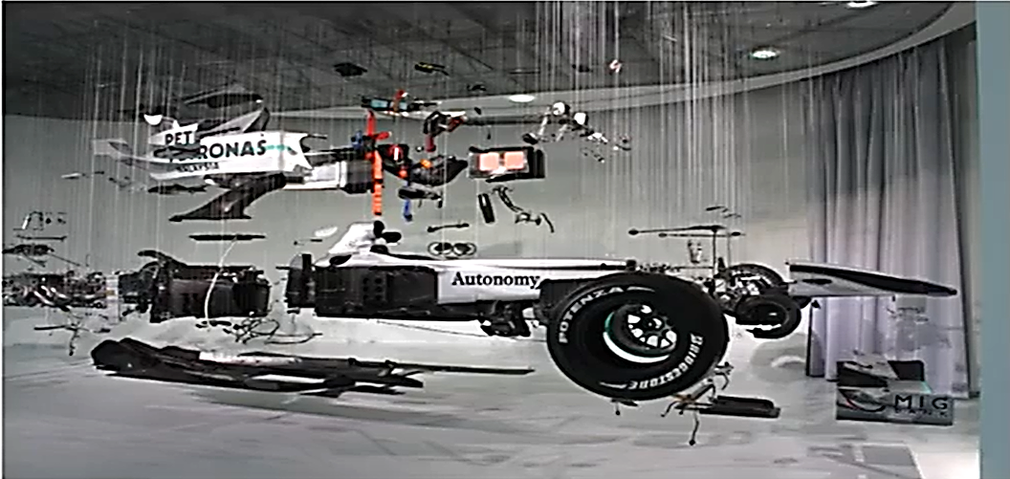
Automotive components

Slide 2
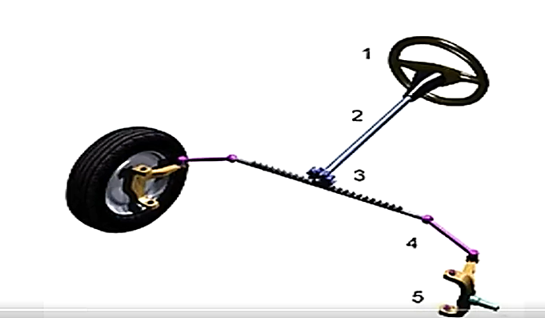
Steering System
The steering system consists of a number of parts and components which together do the task of performing the necessary vehicle steering in different situations. The components are not as much and not as complex as the suspension system but important nevertheless.

Slide 3
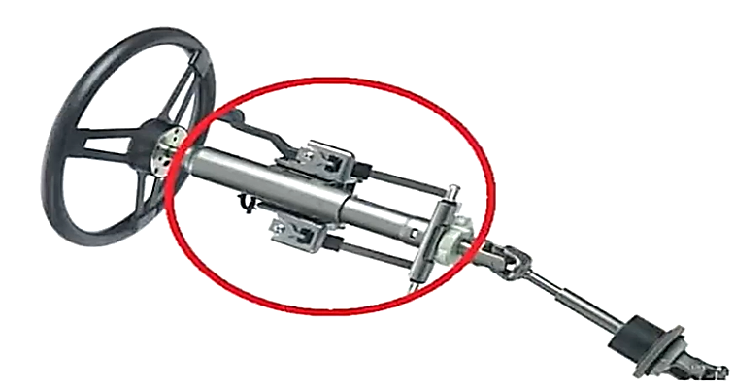
Steering System
Steering and steering column:
The steering is the point of contact between the driver and the steering system. The shape and of the steering decides the required torque for the steering mechanism. The steering and the steering shaft are rigidly attached without any non-aligned or flexible joints.

Slide 4
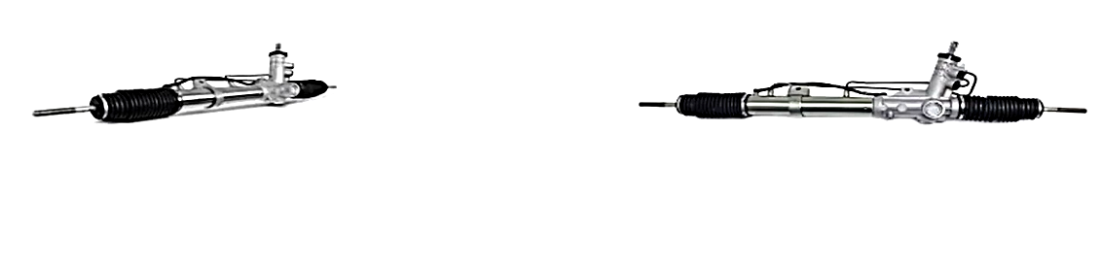
Steering System
Motion Conversion unit (Steering mechanism such as Rack and pinion)
The steering and the steering column provides rotational motion while the wheels require translational motion to be steered. The conversion of the rotational motion to the translational motion

Slide 5
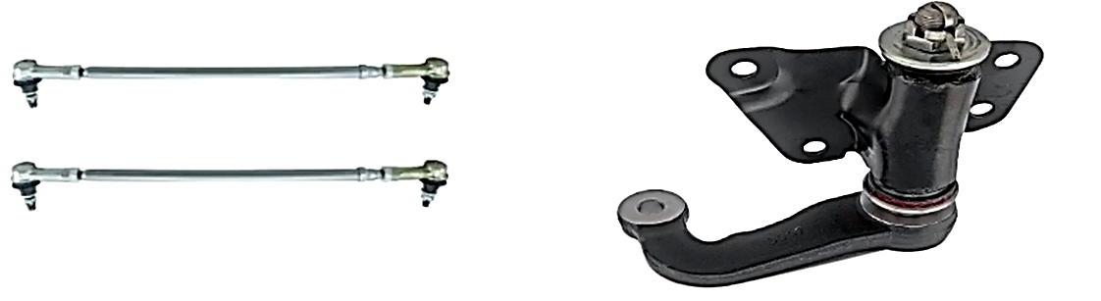
Steering System
Tie rod and steering arm
The tie rod connects the steering rack to the upright of the wheel assembly and further transmits the translational motion from the steering rack to the wheels of the vehicle.
The steering arm on the other hand further acts as the moment arm to turn the wheel around its turning axis.

Slide 6
Thank You

